Slide 1
REAL-TIME ENERGY CONSUMPTION MONITORING USING AI BASED NILM SYSTEM (P2123)
Supervisor
Engr. Umer Farooq
Co-Supervisor
Dr. Hafiz Zia Ur Rehman
Members
Muhammad Salman (211291)
Muhammad Mahmood Ghauri (211265)
Muhammad Moin Dildar (211201)

Slide 2
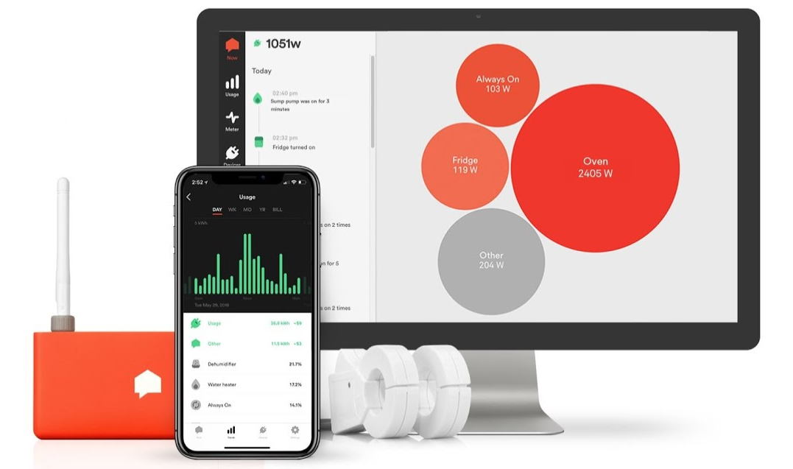
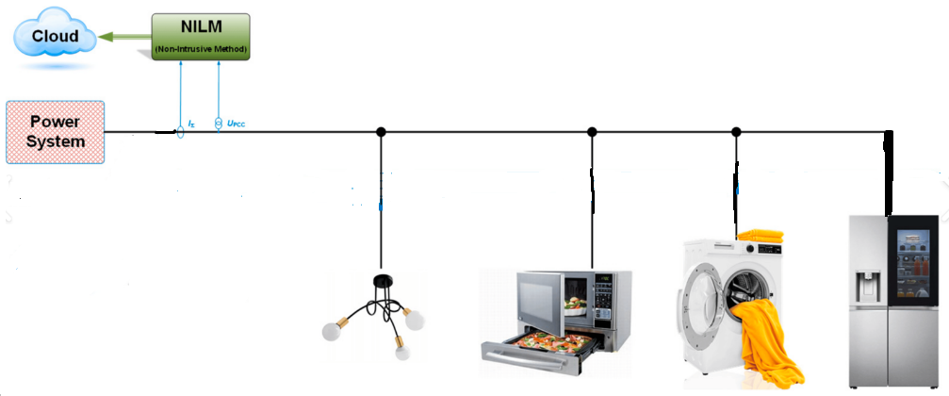
Introduction
The AI-based NILM system is designed to offer real-time energy consumption monitoring for residential and commercial buildings. It leverages advanced AI algorithms and data analytics to detect and forecast the energy usage patterns of individual appliances.

Slide 3
Objective
Identifying the energy consumption of individual device from the selected group of daily use household appliances.
Real time data collection ( stored on server) and analyze to predict the possible power consumption by a specific appliance.
Implementing AI algorithm in Microcontroller.

Slide 4
Methodology
Studying Popular Datasets & Selecting Features
Studied datasets like REDD, UK-DALE, and REFIT to understand how Non-Intrusive Load Monitoring (NILM) tasks work.
Generating a dataset specifically aligned with the goals of our NILM project.
Identify the keys features, focused on essential features such as voltage, current, active power, reactive power, and appliance status for analysis.

Slide 5
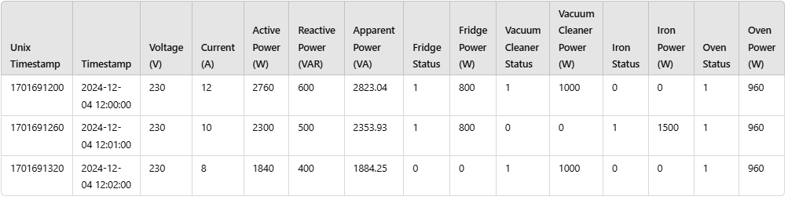
Selected Features
‘

Slide 6
AI Model and Training
Explored various AI models like Sequence-to-Sequence, and Seq2Point for NILM tasks.
Selected the Seq2Point algorithm due to its effectiveness in appliance-level power disaggregation.
Implemented Seq2Point and trained it on the REFIT dataset for specific appliances

Slide 7
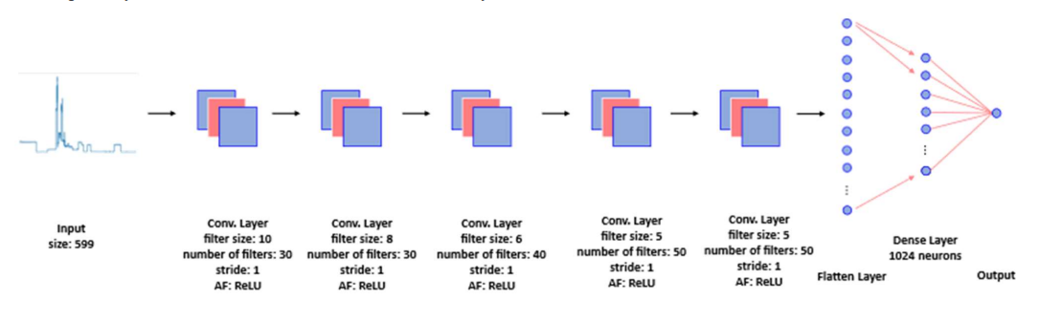
Seq2point Model
;

Slide 8
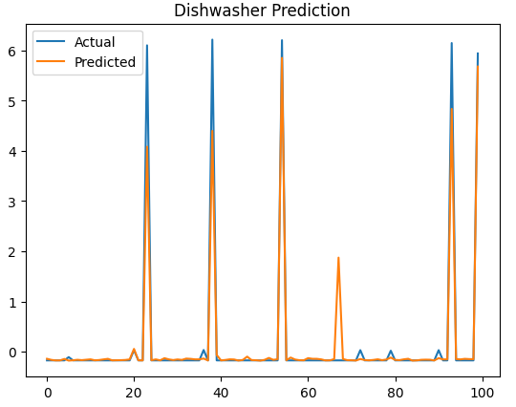
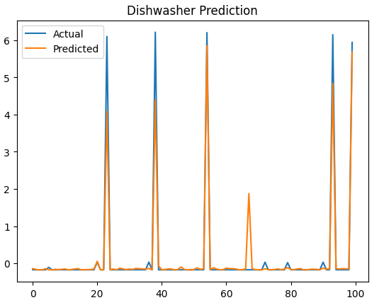
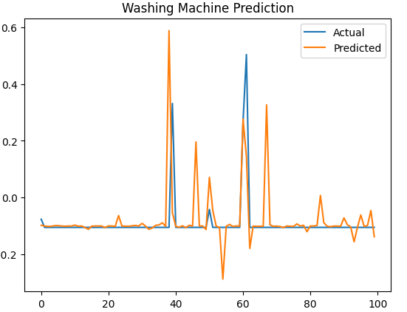
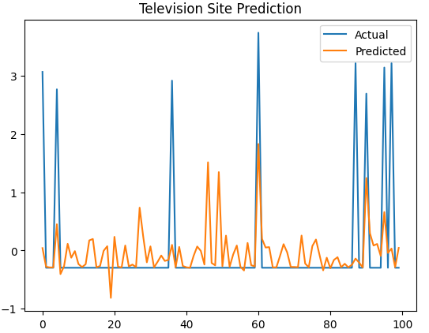
Results

Slide 9
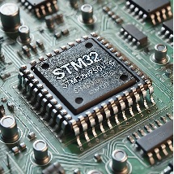
STM32 - microcontroller
The STM32H750VT6 provides an excellent balance of performance, power efficiency.
I have run some basic codes. Also run neural network example on STM using STM32-X Cube IDE.
For this purpose we trained a sine wave model in google collab and then import (.h) file and then implemented on microcontroller and found the given below results

Slide 10
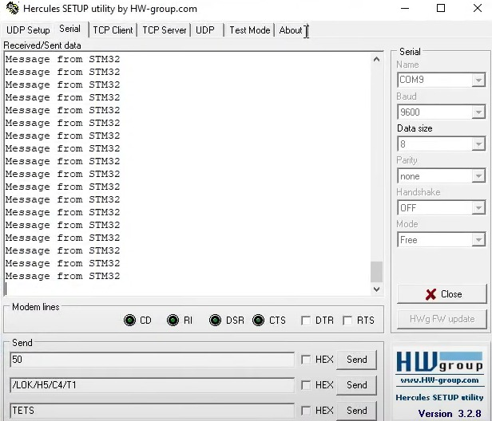
STM32 Serial Communication
We used UART on the STM32 microcontroller to transmit data serially to connected devices efficiently.

Slide 11
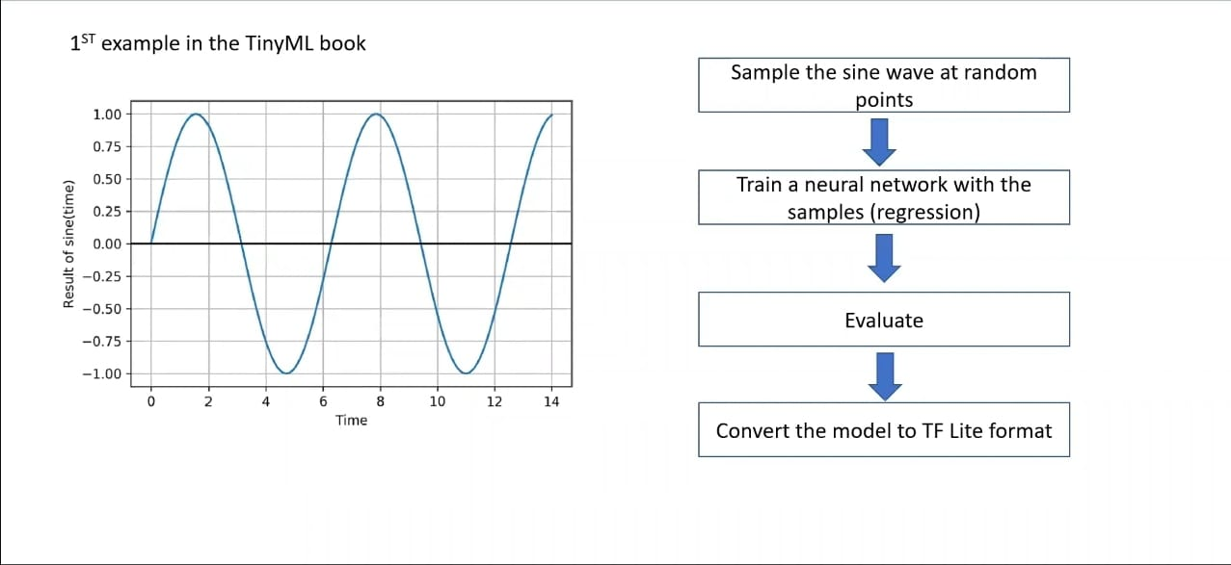
Neural Network Example:

Slide 12
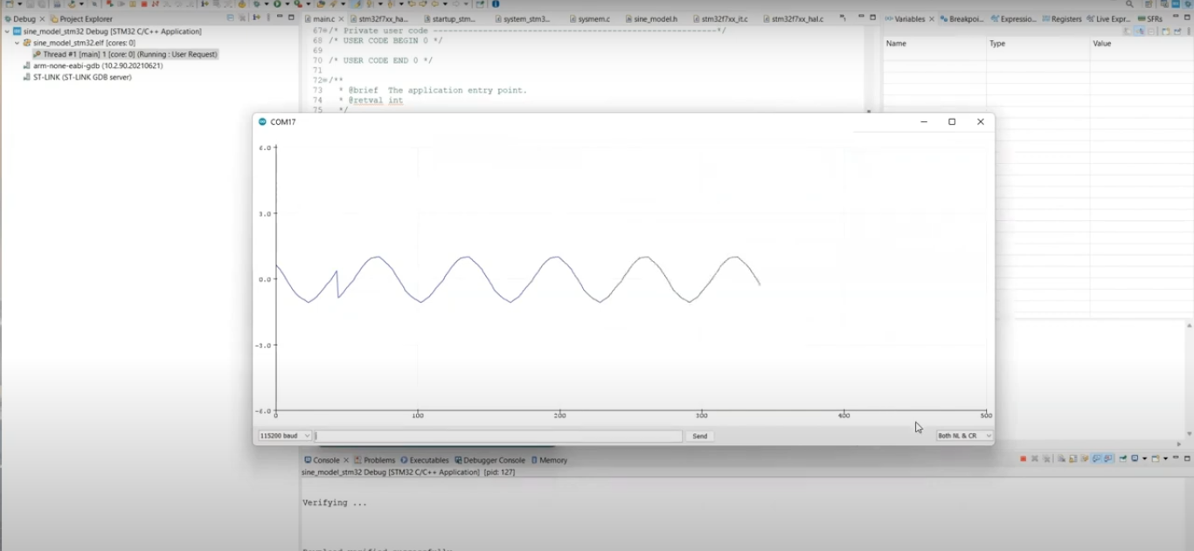
In this Example, trained a neural network model to predict a sine wave and exported the trained model files. Then, we deployed the tf model file on an STM32 microcontroller. The microcontroller was successfully able to predict and generate sine wave outputs based on the model.

Slide 13
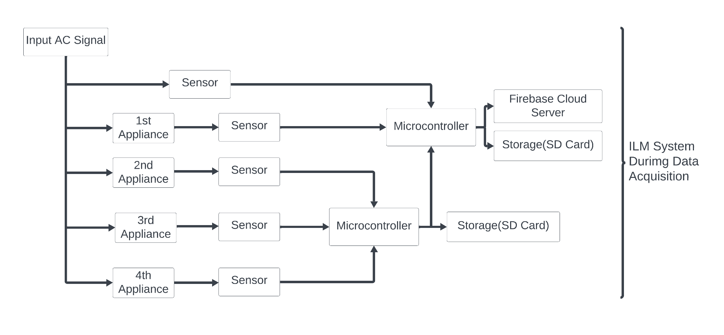
Block Diagram

Slide 14
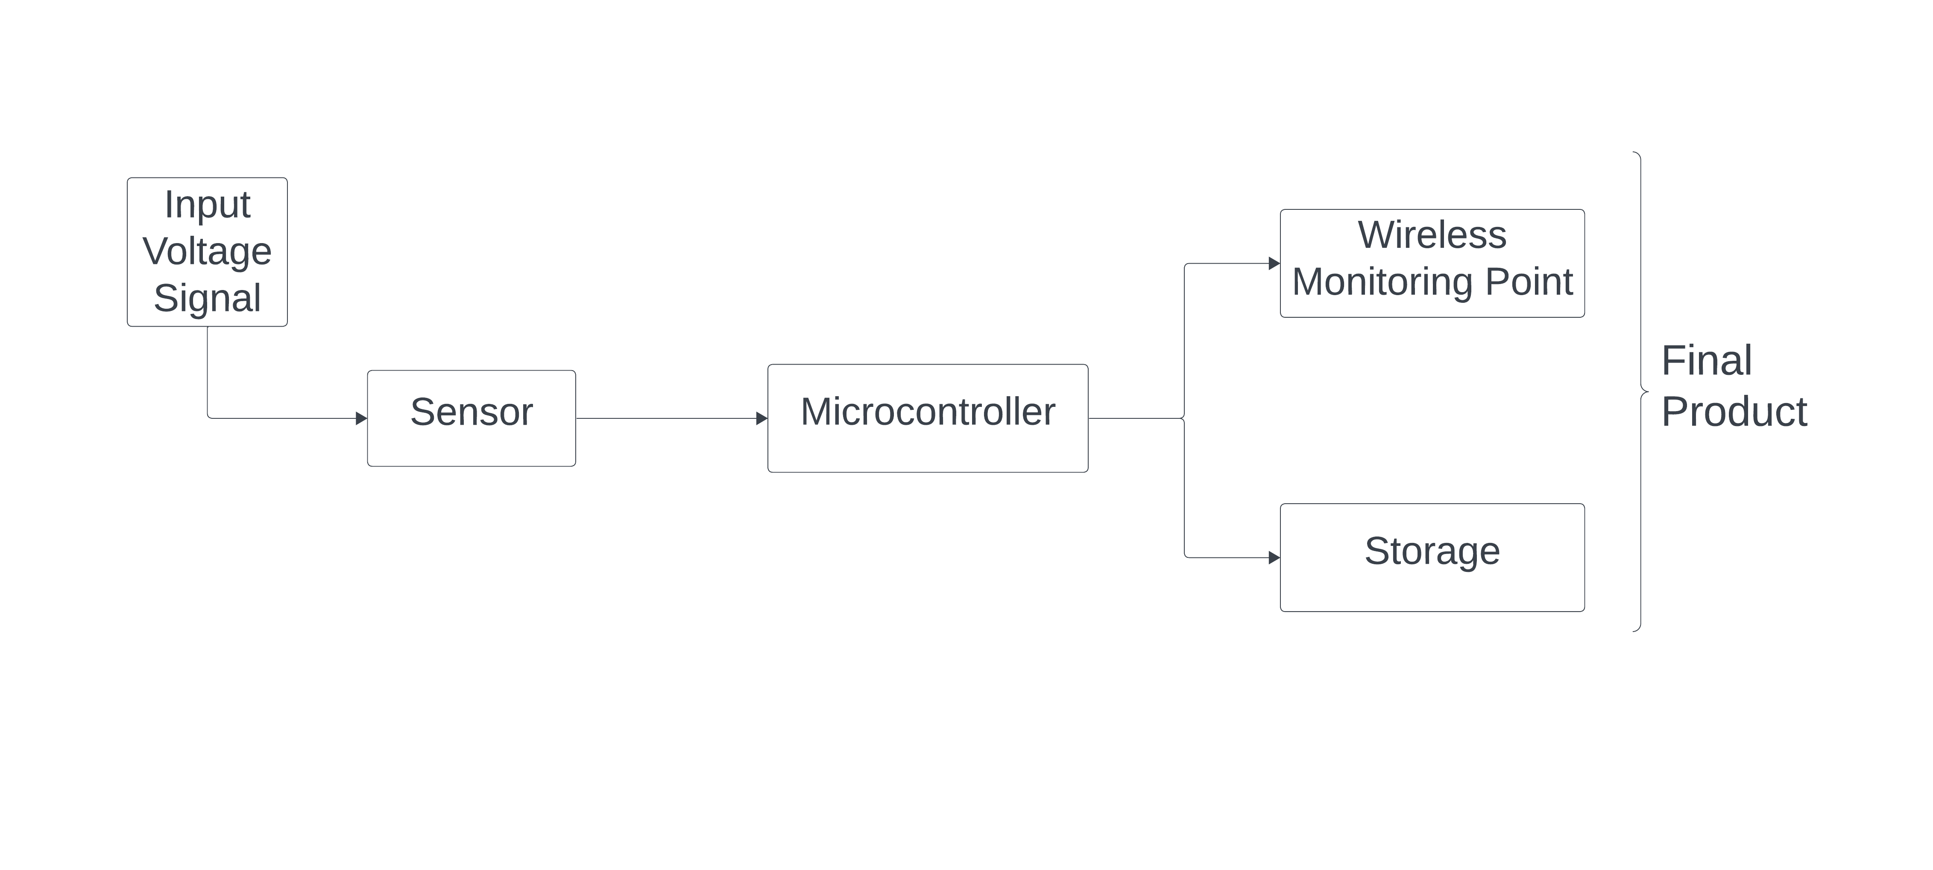

Slide 15
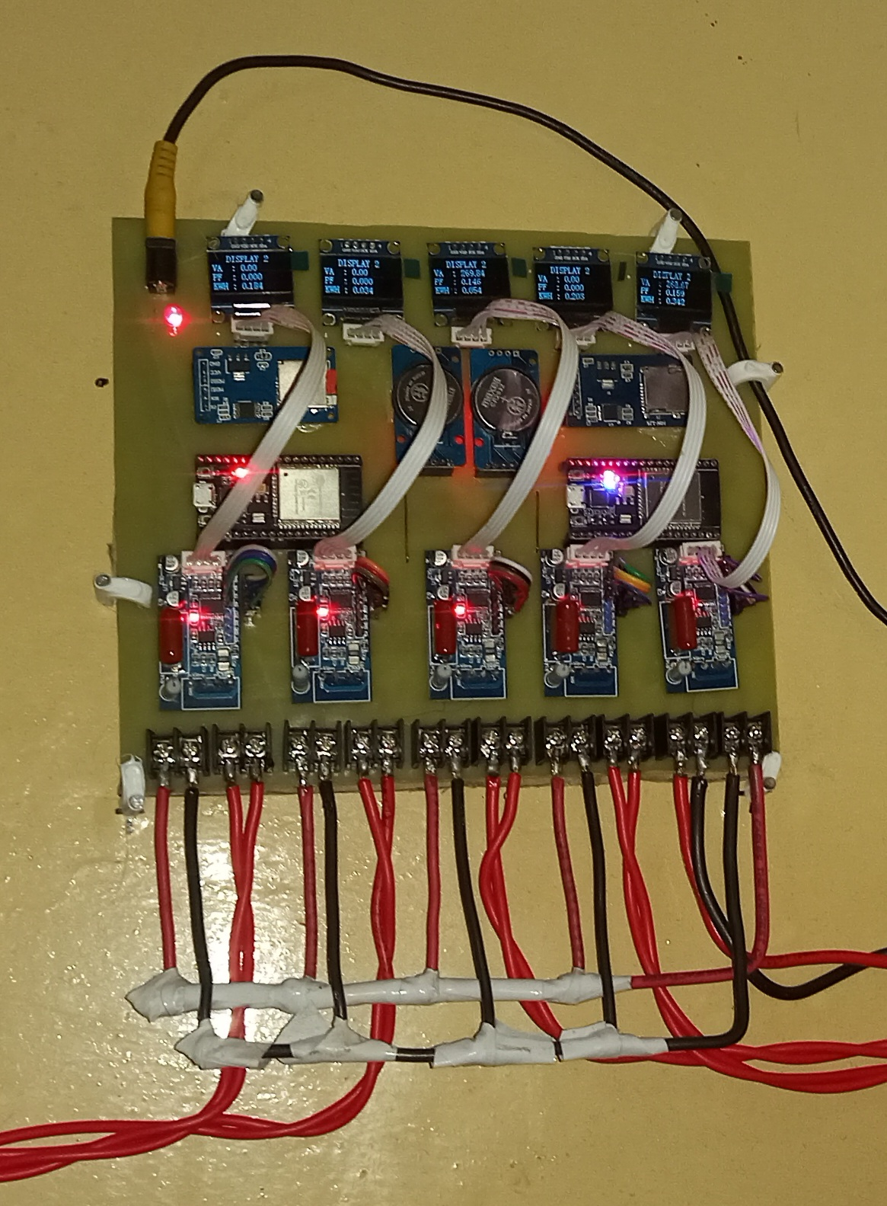
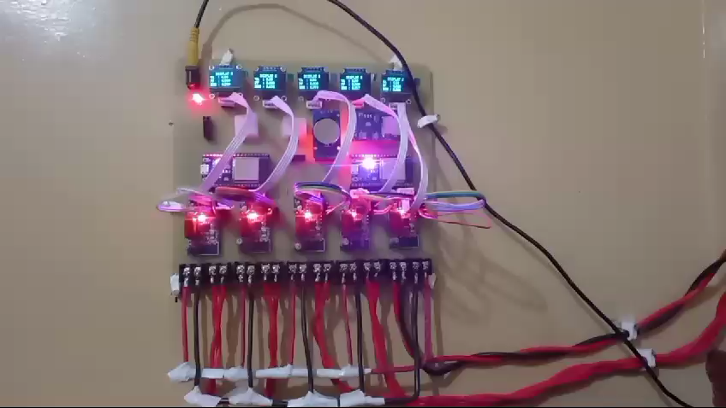
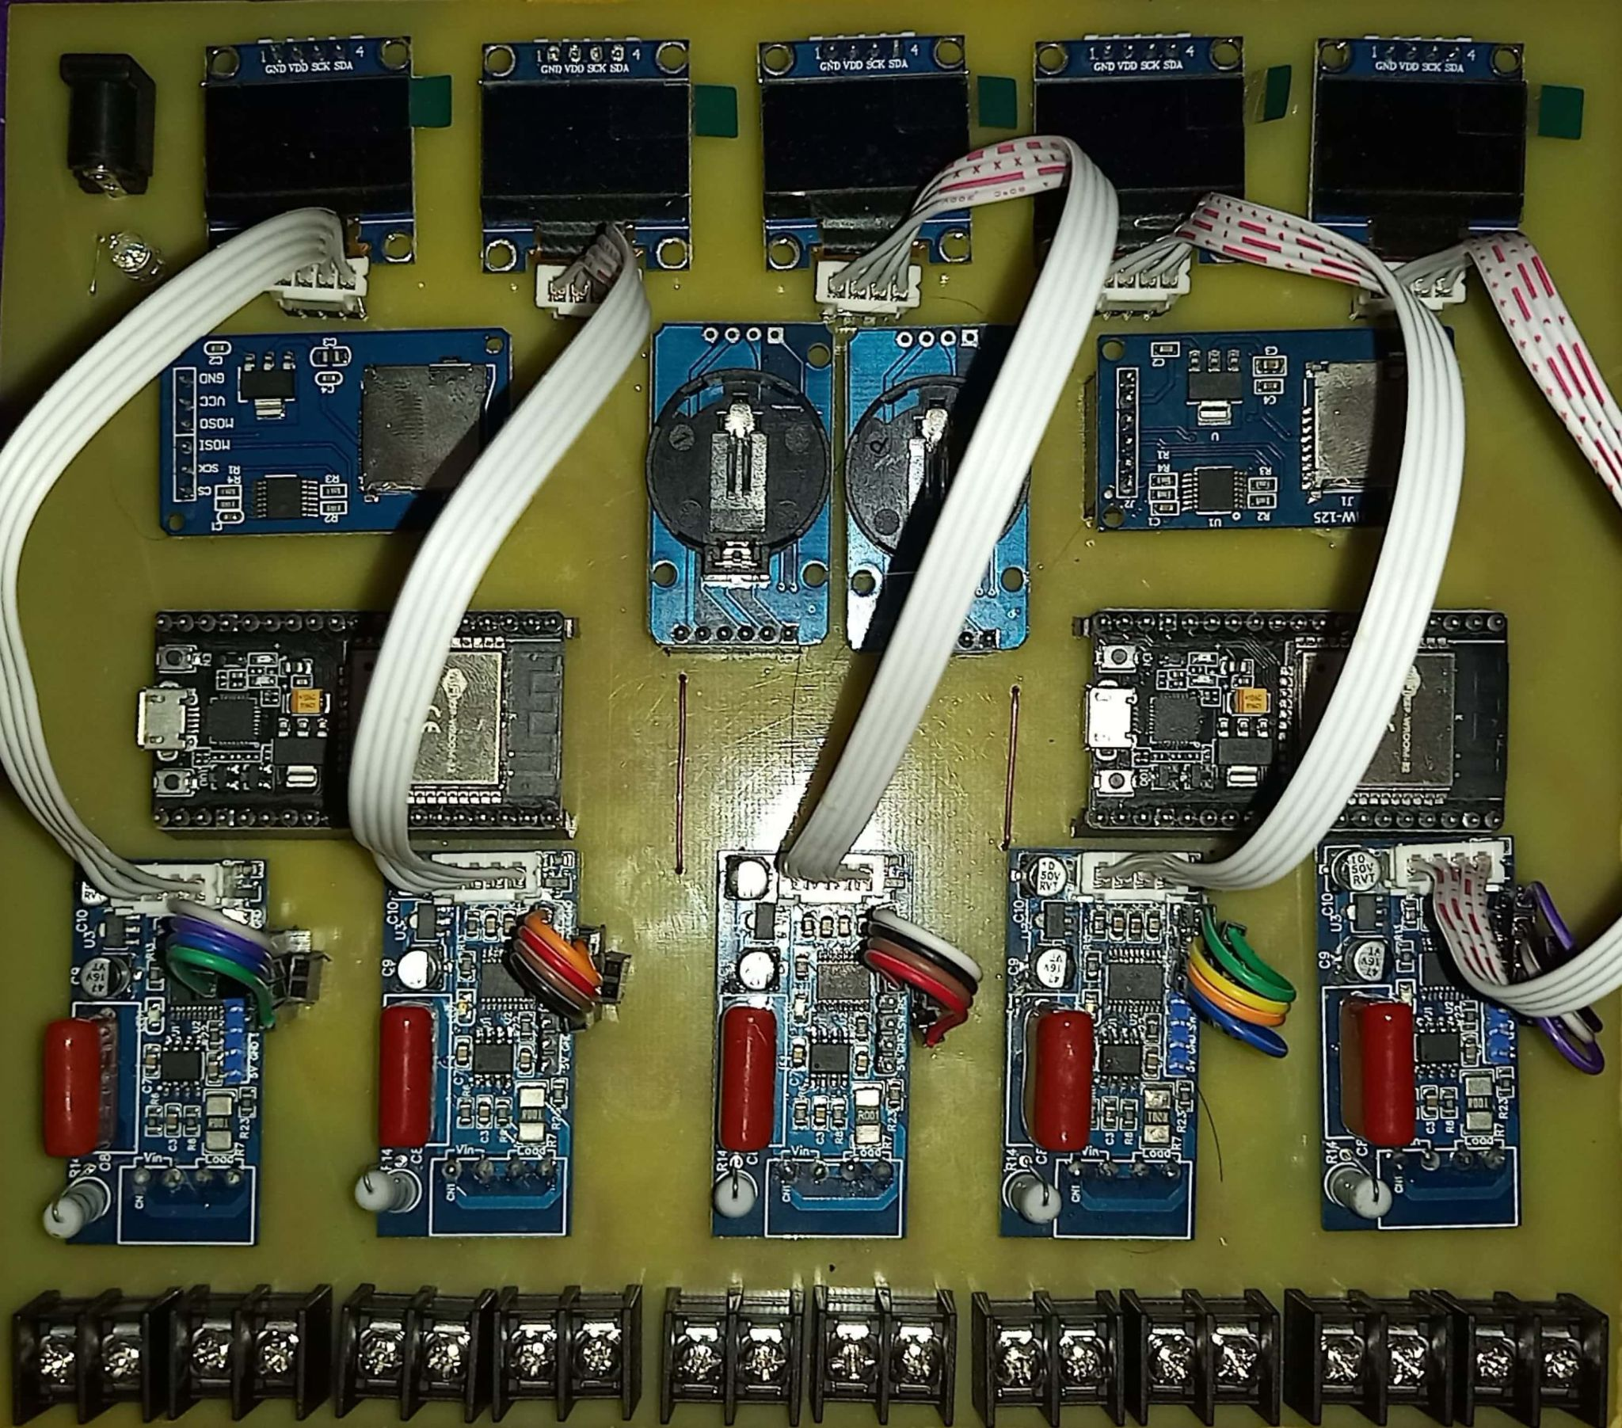
Experimental Setup

